Slide 1
CCNA 200-301, Volume 2
Chapter 11
Quality of Service (QoS)

Slide 2
Objectives
Explain the forwarding per-hop behavior (PHB) for QoS such as classification, marking, queuing, congestion, policing, shaping

Slide 3
Bandwidth, Delay, Jitter, and Loss
Bandwidth: The speed of a link, in bits per second
Delay: One-way delay or round-trip delay between a source and destination
Jitter: The variation in one-way delay between consecutive packets sent by the same source
Loss: The number of loss messages, usually as a percentage of packets sent

Slide 4
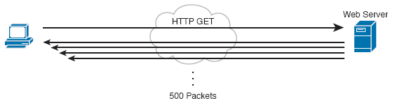
Disproportionate Packet/Byte Volumes with HTTP Traffic

Slide 5
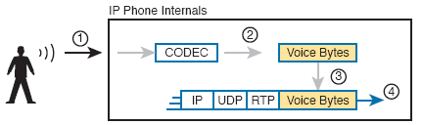
Creating VoIP Packets with an IP Phone and a G.711 Codec

Slide 6
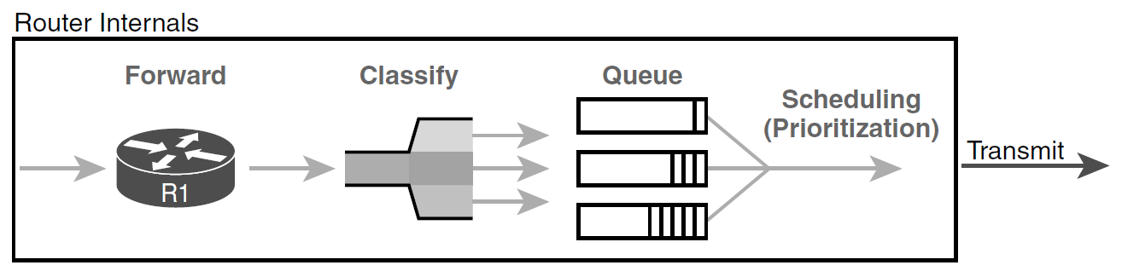
Classification for Queuing in a Router

Slide 7
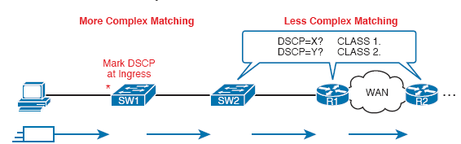
Systematic Classification and Marking for the Enterprise

Slide 8
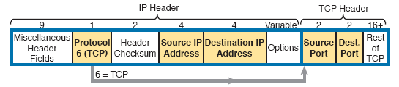
Classification with Five Fields Used by Extended ACLs

Slide 9
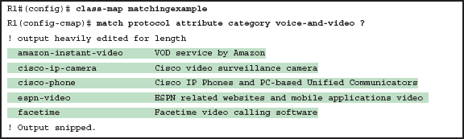
Example of the Many NBAR2 Matchable Applications

Slide 10
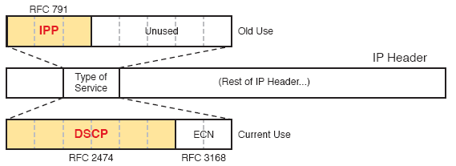
IP Precedence and Differentiated Services Code Point Fields

Slide 11
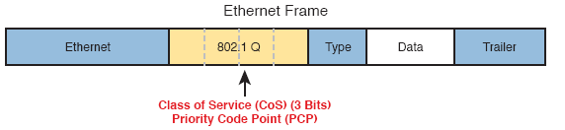
Class of Service Field in 802.1Q/p Header

Slide 12
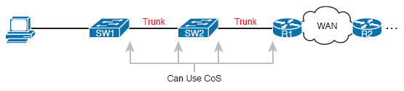
Useful Life of CoS Marketing

Slide 13
Marking Fields
Field Name | Header(s) | Length (bits) | Where Used
DSCP | IPv4, IPv6 | 6 | End-to-end packet
IPP | IPv4, IPv6 | 3 | End-to-end packet
CoS | 802.1Q | 3 | Over VLAN Trunk
TID | 802.11 | 3 | Over Wi-Fi
EXP | MPLS Label | 3 | Over MPLS WAN

Slide 14
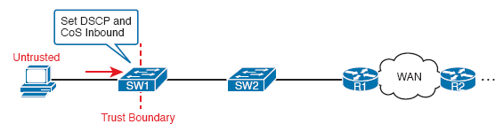
Defining Trust Boundaries—PC

Slide 15
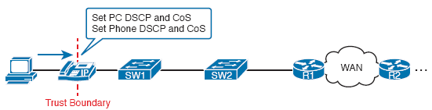
Defining Trust Boundaries—IP Phone

Slide 16
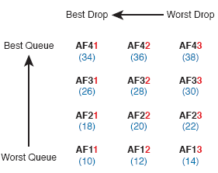
Differentiated Services Assured Forwarding Values and Meaning

Slide 17
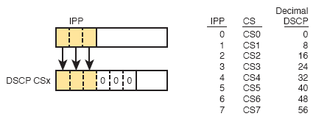
Class Selector

Slide 18
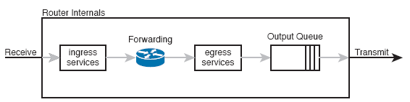
Output Queuing in a Router: Last Output Action Before Transmission

Slide 19
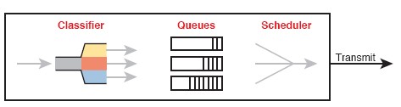
Queuing Components

Slide 20
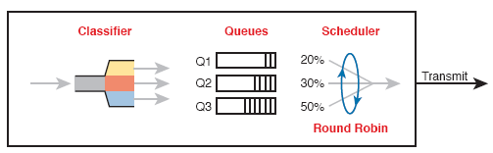
CBWFQ Round-Robin Scheduling

Slide 21
QoS Requirements for a VoIP Call per Cisco Voice Design Guide
Bandwidth/call | One-way Delay (max) | Jitter (max) | Loss (max)
30-320 Kbps | 150 ms | 30 ms | <1%

Slide 22
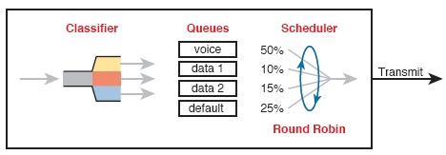
Round Robin Not Good for Voice Delay (Latency) and Jitter

Slide 23
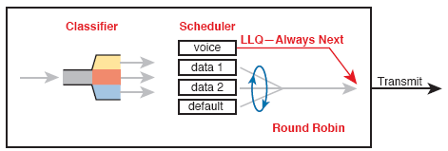
LLQ Always Schedules Voice Packet Next

Slide 24
Prioritization Strategy for Data, Voice, and Video
Use a round robin queuing method like CBWFQ for data classes and for noninteractive voice and video.
If faced with too little bandwidth compared to the typical amount of traffic, give data classes that support business-critical applications much more guaranteed bandwidth than is given to less important data classes.
Use a priority queue with LLQ scheduling for interactive voice and video, to achieve low delay, jitter, and loss.

Slide 25
Prioritization Strategy for Data, Voice, and Video (continued)
Put voice in a separate queue from video, so that the policing function applies separately to each.
Define enough bandwidth for each priority queue so that the built-in policer should not discard any messages from the priority queues.
Use Call Admission Control (CAC) tools to avoid adding too much voice or video to the network, which would trigger the policer function.

Slide 26
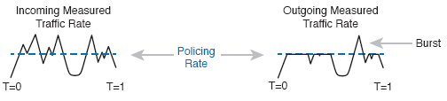
Effect of a Policer and Shaper on an Offered Traffic Load

Slide 27
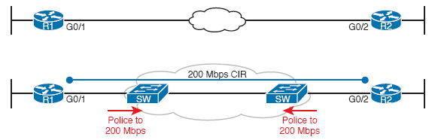
Ethernet WAN: Link Speed Versus CIR

Slide 28
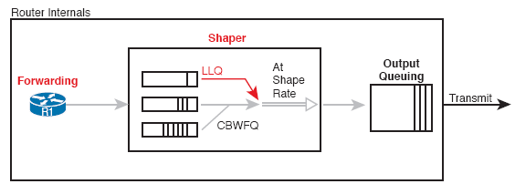
Shaping Queues: Scheduling with LLQ and CBWFQ

Slide 29
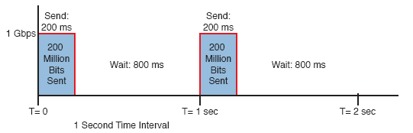
One Second (1000 ms) Shaping Time Interval, Shaping at 20 Percent of Line Rate

Slide 30
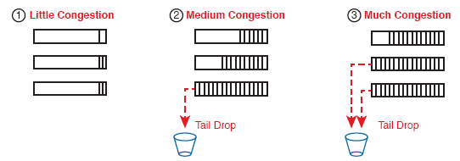
Tail Drop Concepts with Three Different Scenarios

Slide 31
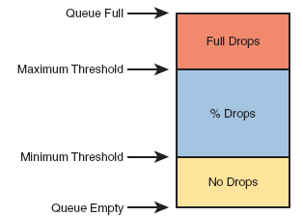
Mechanisms of Congestion Avoidance

